Slide 1

Aligning Your Company and Your QA Team:
One group’s approach Grant Quail
Los Angeles
March 03, 2020

Slide 2
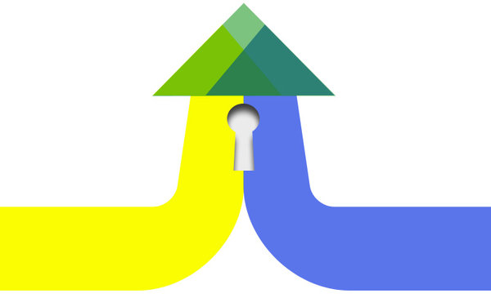
Technology Process
vs.

Slide 3
"How soon can you finish testing?"
"That’s not a real bug."
"We have surprise code you need to test .. right now."

Slide 4
"We don’t have time to do testing"
"How did QA miss this bug?"
"You’re worried about nothing. We don’t need to check that."

Slide 5
Cause: Lack of Alignment
Visibility:
People see what the QA team is testing
Influence:
QA team can affect design, dev, deployment

Slide 6


Magicians
“Everything should go through QA”
Low Visibility
Low Influence

Slide 7


Gatekeepers
“Every release must be approved by QA”
Low Visibility
High Influence

Slide 8

Robots
“We only need QA for testing”
High Visibility
Low Influence

Slide 9

Partners
“QA should contribute to the entire process”
High Visibility
High Influence

Slide 10
Our Goal
Influence
Visibility

Slide 11

Action Strategy
Define Mission
Identify activities
Build Buy-In
Sustain & Improve

Slide 12

Build Mission Statement

Slide 13
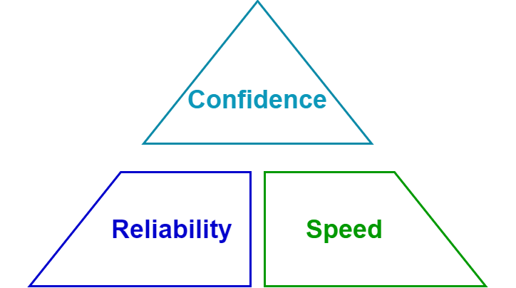
Build Mission Statement

Slide 14
Build Mission Statement
“Provide confidence that we are quickly building reliable software.”

Slide 15
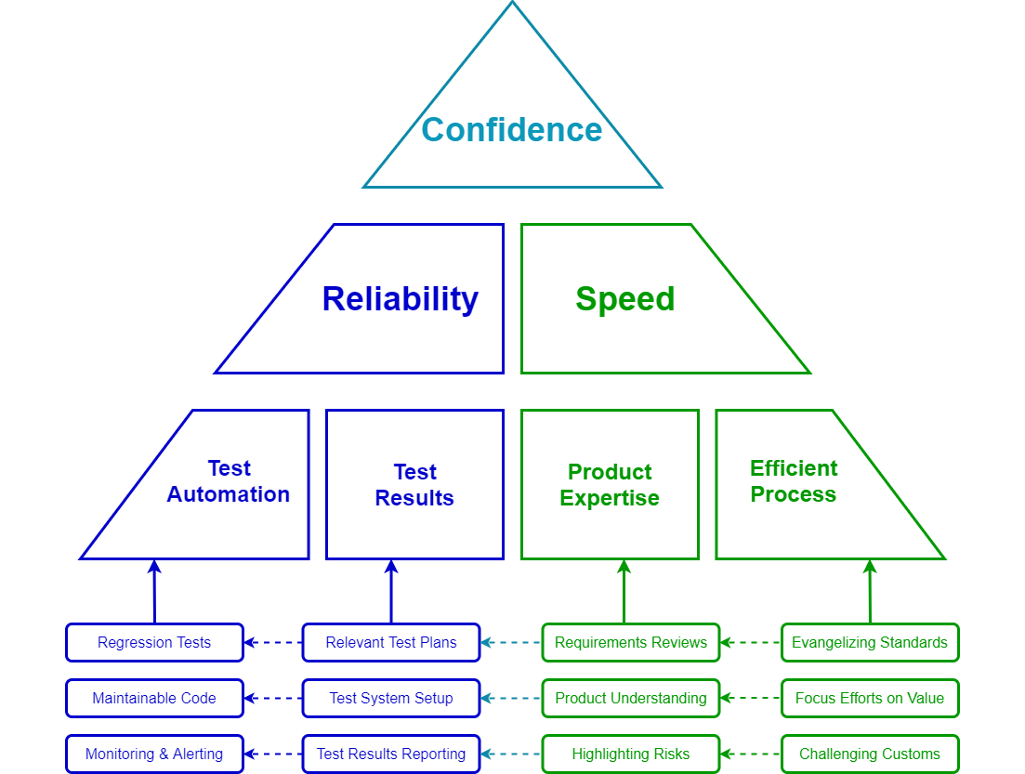
Break Apart Activities

Slide 16
Evangelize Aligning Activities
Improve Visibility
Publish Test Plans
Report Test Results
Vocalize Risks
Improve Influence
Story Standards
Requirements Reviews
Acceptance Reviews

Slide 17



Buy-In Building Techniques
Internal Buy-In
Team presentation
Integrate feedback
Listen
External Buy-In
Benefits Focused
Bottom Up …
… Top Down

Slide 18

Sustaining & Improving
Sustaining:
Documentation Culture
Radiate from QA team
Frequent contact with peers
Improving:
Actively Seek feedback
Rollback failed ideas quickly
Apply “Agile Process” to improving process

Slide 19

Broad Highlights
Better Alignment reduces friction
Alignment = Visibility + Influence
Mission statement focuses plans
Ensure your team members are heard

